Slide 1
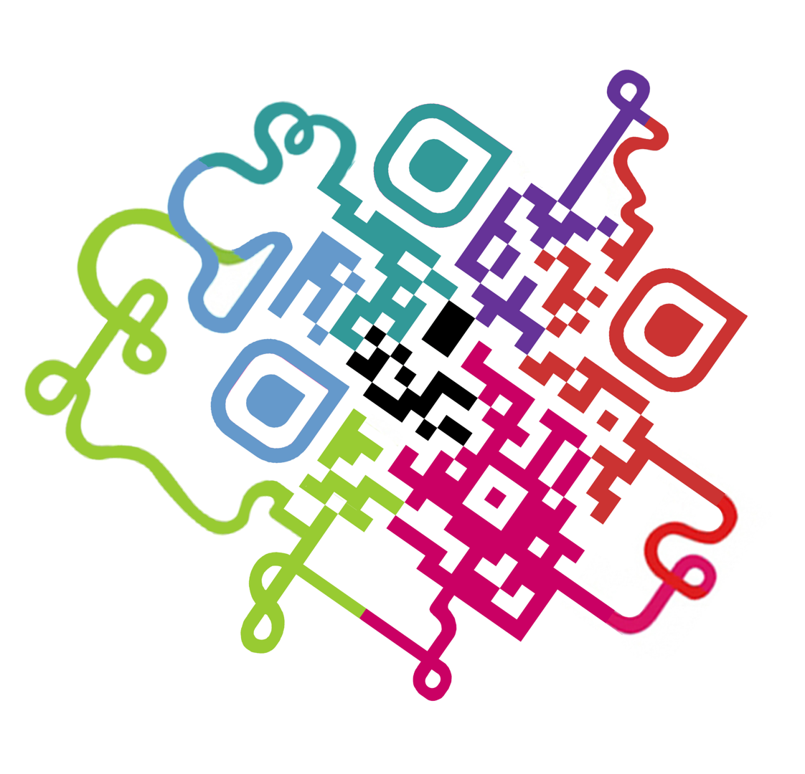
Designing and Building Secure Software
--Sri Harsha, CyberEye.

Slide 2
Making secure software:-
Flawed approach: Design and build software, and ignore security at first
Add security once the functional requirements are satisfied
Better approach: Build security in from the start
Incorporate security-minded thinking into all phases of the development process.

Slide 3
Development process
Many development processes; four common phases:
Requirements
Design
Implementation
Testing/assurance
Phases of development apply to the whole project, its individual components, and its refinements/iterations
Where does security engineering fit in?
All phases!

Slide 4
Software vs. Hardware
System design contains software and hardware
Mostly, we are focusing on the software
Software is malleable and easily changed
Advantages to core functionality
Harmful to security (and performance)
Hardware is fast, but hard to change
Disadvantages to evolution
Advantage to security
Can’t be exploited easily, or changed by an attack.

Slide 5
Secure Hardware:-
Security functionality in hardware
Intel’s AES-NI implements cryptographic instructions
Intel SGX supports “encrypted computation”
For cloud computing applications
Hardware primitives for security
Physically uncloneable functions (PUFs)
Source of unpredictable, but repeatable, randomness, useful for authentication
Intel MPX - primitives for fast memory safety enforcement

Slide 6
Threat Modeling
(Architectural Risk Analysis)

Slide 7
Threat Model:-
The threat model makes explicit the adversary’s assumed powers
Consequence: The threat model must match reality, otherwise the risk analysis of the system will be wrong
The threat model is critically important
If you are not explicit about what the attacker can do, how can you assess whether your design will repel that attacker?
This is part of architectural risk analysis

Slide 8
Example: Network User
An (anonymous) user that can connect to a service via the network
Can:
Measure the size and and timing of requests and responses
run parallel sessions
provide malformed inputs, malformed messages
Drop or send extra messages
Example attacks: SQL injection, XSS, CSRF, buffer overrun/ROP payloads, ….

Slide 9
Example: Snooping User
Internet user on the same network as other users of some service
For example, someone connected to an unencrypted wi-fi network at a coffee shop
Thus, can additionally
Read/measure others’ messages.
Intercept, duplicate, and modify messages
Example attacks: Session hijacking (and other data theft), privacy-violating side-channel attack, denial of service

Slide 10
Example: Co-located User
Internet user on the same machine as other users of some service
E.g., malware installed on a user’s laptop
Thus, can additionally
Read/write user’s files (e.g., cookies) and memory
Snoop keypresses and other events
Read/write the user’s display (e.g., to spoof)
Example attacks: Password theft (and other credentials/secrets)

Slide 11
Threat-driven Design
Different threat models will elicit different responses
Network-only attackers implies message traffic is safe
No need to encrypt communications
This is what telnet remote login software assumed
Snooping attackers means message traffic is visible
So use encrypted wifi (link layer), encrypted network layer (IPsec), or encrypted application layer (SSL)
Co-located attacker can access local files, memory
Cannot store unencrypted secrets, like passwords

Slide 12
Bad Model = Bad Security
Any assumptions you make in your model are potential holes that the adversary can exploit
E.g., Assuming no snooping users no longer valid
Prevalence of wi-fi networks in most deployments
Other mistaken assumptions
Assumption: Encrypted traffic carries no information
Not true! By analyzing the size and distribution of messages, you can infer application state
Assumption: Timing channels carry little information
Not true! Timing measurements of previous RSA implementations could be used eventually reveal a remote SSL secret key

Slide 13
Finding a good model
Compare against similar attacks
What attacks does their design contend with?
Understand past attacks and attack patterns
How do they apply to your system?
Challenge assumptions in your design
What happens if an assumption is untrue?
What would a breach potentially cost you?
How hard would it be to get rid of an assumption, allowing for a stronger adversary?

